Slide 1
Presentation of Electronic voting System

Slide 2
Introduction
These days, there is a decrease of the amount pf people who vote using the manual registration. This is as a result of it being a long and tedious activity. Thus, e-voting was made in order to get people to vote without the disadvantages listed above.
E-voting is the process by which people vote through electronic devices. Good e-voting systems can be used on any device and can be accessible anywhere at any time.
My e-voting website and application provides a good, secure platform for people to cast their votes and be rest assured that in the end, the voting system does give accurate results.

Slide 3
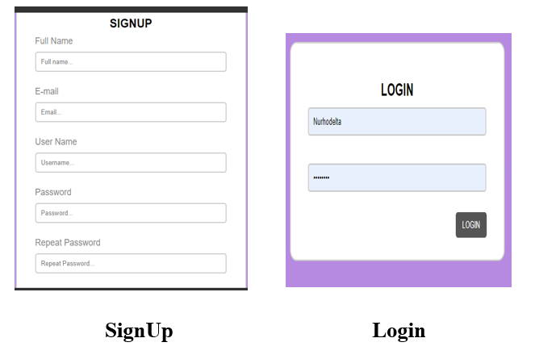
Capabilities of the App/Website
Electorates will need to sign up or log in to get their information into the database and allow them to vote.

Slide 4
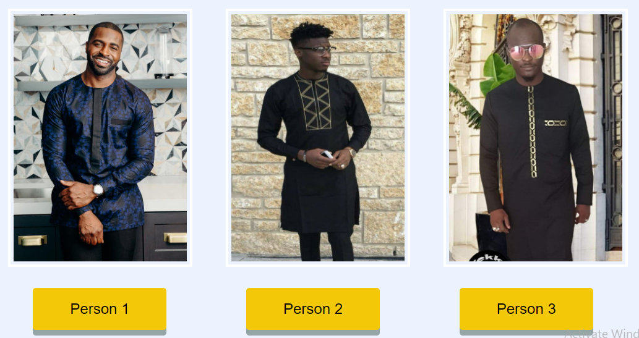
Electorates can vote for the person of their choice

Slide 5

Electorates can see the results of their votes after they vote.

Slide 6

Electorates can log out after they are done voting.

Slide 7
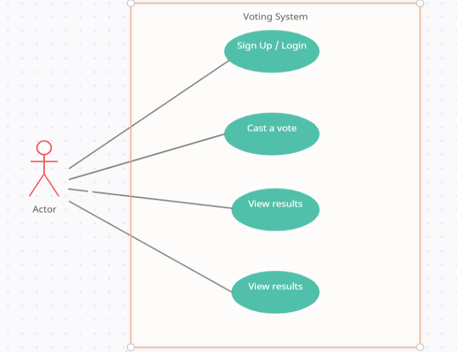
Interaction Model
The interaction model shows the electorate’s ability to login, sign up, cast a vote, view the results at the time and log out.

Slide 8
Thank You !

